Slide 1
Population dynamics project: Internal dynamics of NPZD type ecosystem models
Jaume Colom and Abraham Cano
Mathematical models in biology
FME-UPC
Notes:
Presentació del projecte
- Benvinguda
Noms
Assignatura
Nom del paper

Slide 2
Content
The problem
Proposal
Results
Our proposal
Notes:
The problem: Quin context estem treballant? Per qué ens interessa? Conseqüencies, etc.
Proposal: Com és el model? Qué es cada lletra? Com afecten? Explicar lleugerament les eqs
Results: Molt rapidament els tres punts de equilibri i estabilitat
Our proposal: Afegir un component dinàmic de la llum. Com més plankton menos llum INVENTAR.

Slide 3
The problem

Slide 4
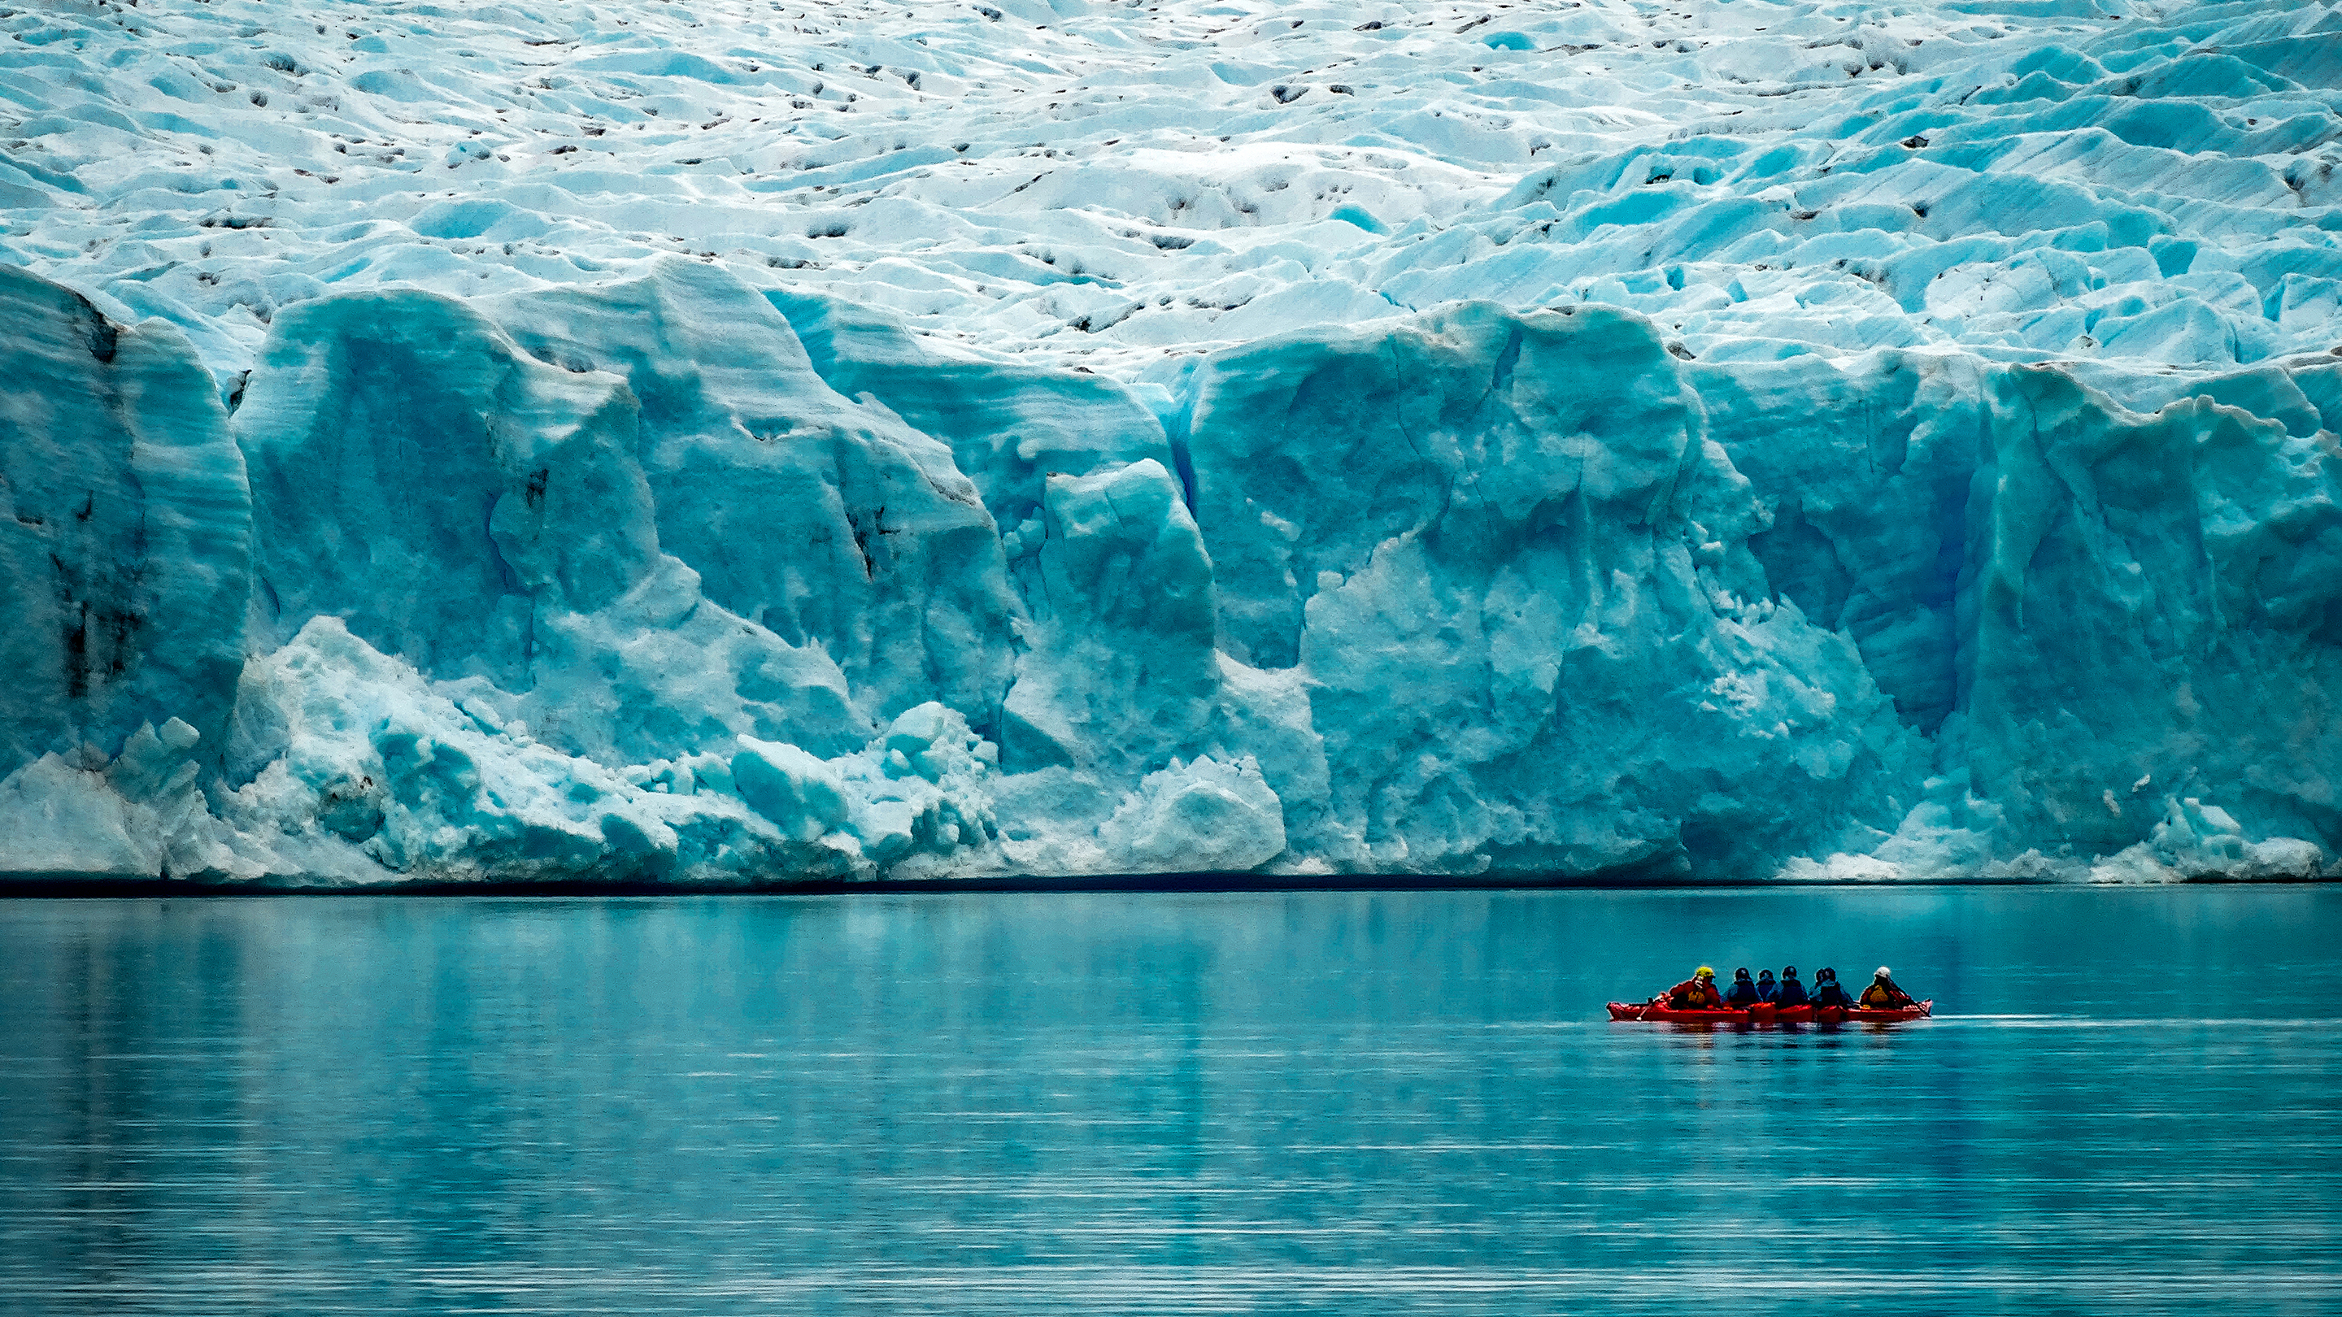
The problem I: Climate change
Source: https://www.quantamagazine.org/how-earths-climate-changes-naturally-and-why-things-are-different-now-20200721/

Slide 5
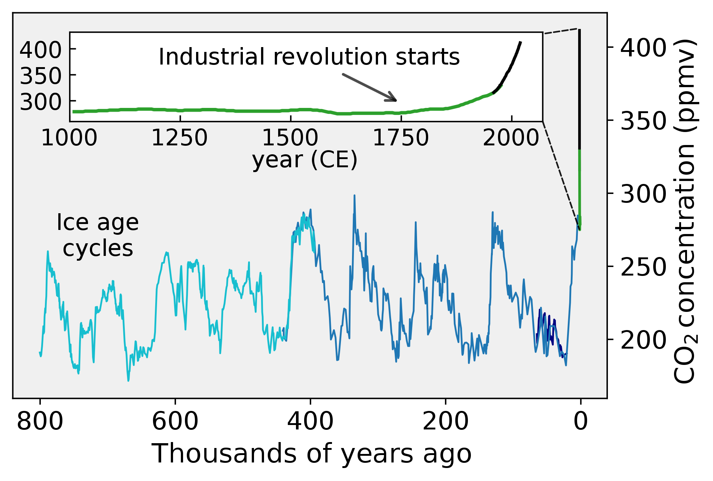
The problem II: CO2 concentration
Source: https://github.com/Femkemilene/Global-Warming-Figures

Slide 6
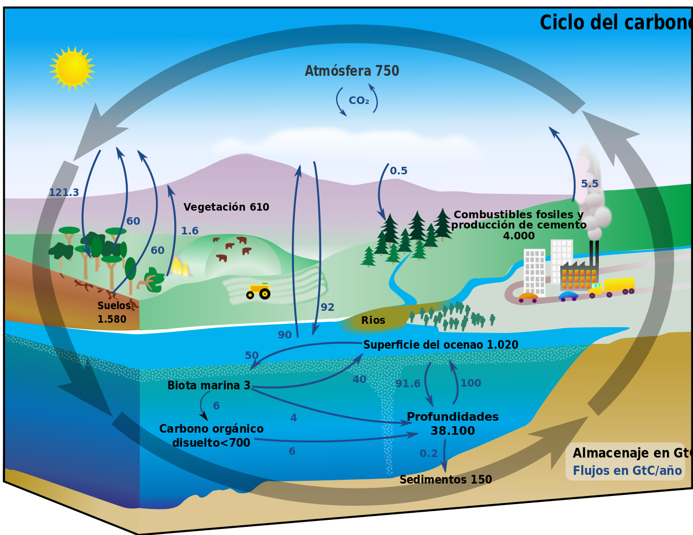
The problem III: The carbon cycle
Source: https://es.wikipedia.org/wiki/Ciclo_del_carbono#/media/Archivo:Carbon_cycle-cute_diagram.svg
Notes:
The marine ecosystem is an essential part of the Earth carbon cycle

Slide 7
The problem IV: The marine ecosystem (ocean) is an essential part of the Earth carbon cycle
Source: https://es.wikipedia.org/wiki/Ciclo_del_carbono#/media/Archivo:Carbon_cycle-cute_diagram.svg
Notes:
The marine ecosystem is an essential part of the Earth carbon cycle

Slide 8
The problem V: How to model the ocean?
Oceanography
Biological Oceanography
Chemical Oceanography
Geological Oceanography
Physical Oceanography

Slide 9
The problem V: How to model the ocean?
Oceanography
Biological Oceanography
Chemical Oceanography
Geological Oceanography
Physical Oceanography

Slide 10
The problem V: How to model the ocean?
Oceanography
Biological Oceanography -> Marine ecosystem
Chemical Oceanography
Geological Oceanography
Physical Oceanography

Slide 11
The problem VI: How to model the marine ecosystem?

Slide 12
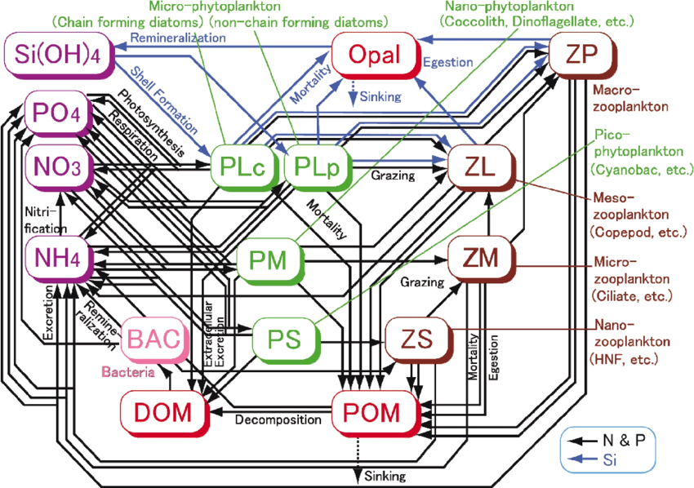
The problem VI: How to model the marine ecosystem?
Source: Yoshie, Naoki & Guo, Xinyu & Fujii, Naoki & Komorita, Tomohiro. (2011). Ecosystem and Nutrient Dynamics in the Seto Inland Sea, Japan. Interdisciplinary studies on environmental chemistry. 39-49.

Slide 13
Proposal: NPZD model
Nutrients (NO3)
Phytoplankton
Zooplankton
Detritus

Slide 14
NPZD models: What are they used for?
NPZD models (and concentration based models, more generally) are tools for quantitative investigation of a planktonic ecosystem
3 broad uses:
Theoretical experiments
Explanation of observations
Prediction

Slide 15
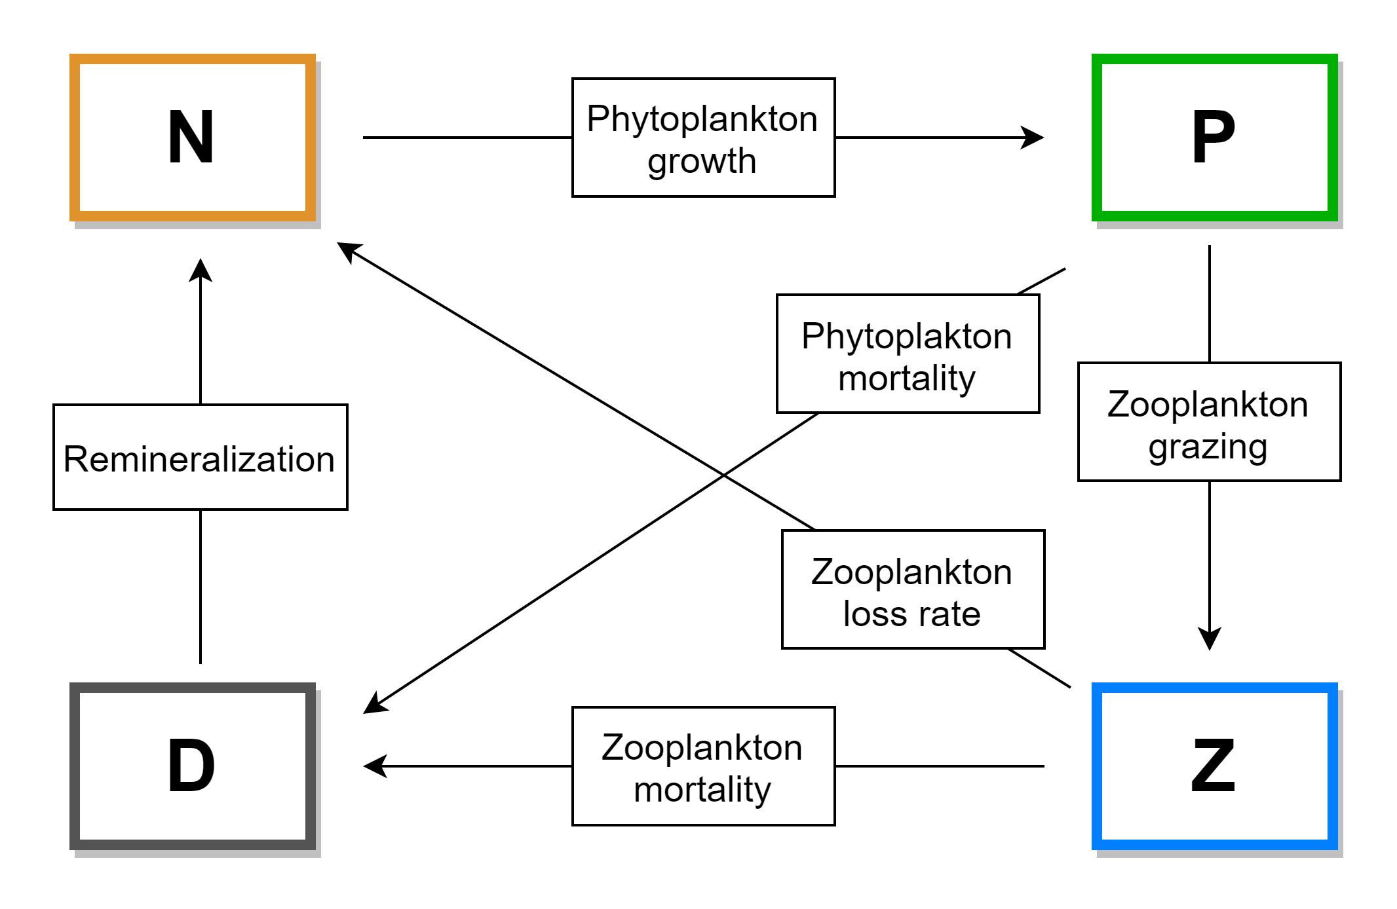
Proposal: NPZD model
Nutrients (NO3)
Phytoplankton
Zooplankton
Detritus

Slide 16
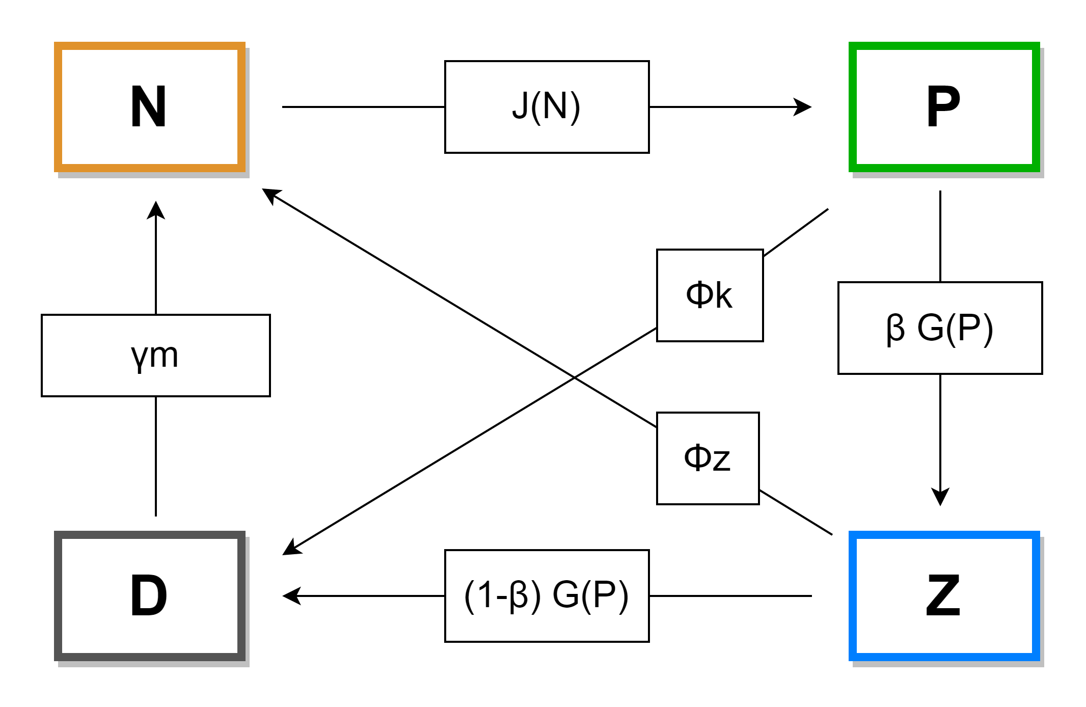
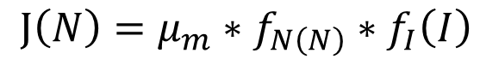
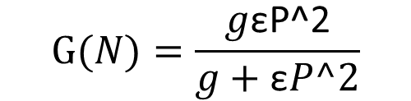
Proposal: NPZD model
$$J\left(N\right)=μ_{m}∗f_{N\left(N\right)}∗f_{I}\left(I\right)$$
$$G(N)=\frac{g\text{ε}\text{P}\text{^2}}{g+\text{ε}P^2}$$

